Slide 1
AI IN EDUCATION
Workshop for exploring the use of AI in Education at Jönköping University and beyond
Educate, 2023-05-17

Slide 2
Contents
Introduction – What is AI?
Considerations for teachers
Ethical guidelines
Examples for teachers
Examination

Slide 3
Introduction
What is AI?
Why the current hype?
What is generative AI?
Impact on education?

Slide 4
What is AI?
Artificial Intelligence: Several methods of building models that can solve tasks
Speech recognition
Spam filter
Translation
Games
Robotic vehicles
…
1950 –

Slide 5
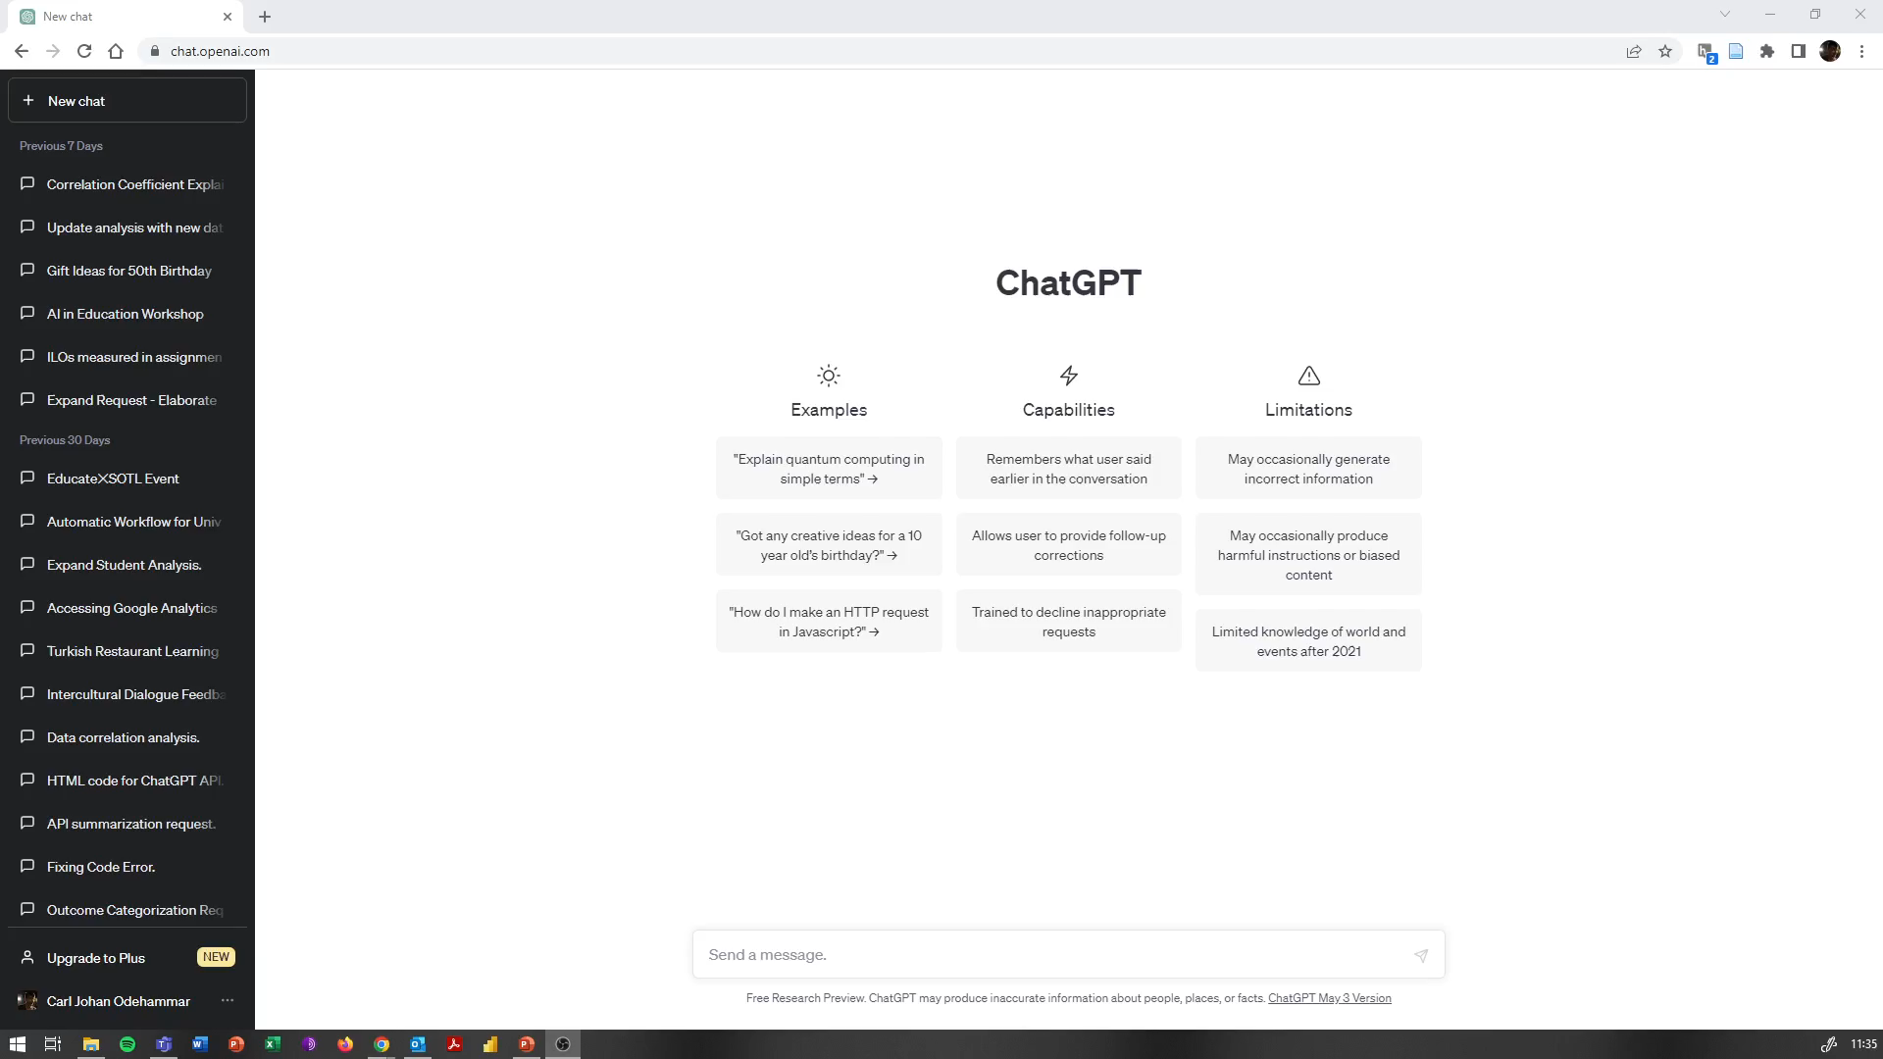
Notes:
https://openai.com/blog/chatgpt

Slide 6
What is generative AI?
AI built to create content
Text
Image
Video
Audio
A model of the content is created based on large sets of training data
The model is used to generate new content
Notes:
https://www.midjourney.com/showcase/top/

Slide 7
GPT
Generative Pre-trained Transformer
Large Language Model (LLM)
Creates text according to statistical probability
What is the next most likely word, given the previous content and initial prompt?

Slide 8



Examples of Generative AI chatbots
ChatGPT (OpenAI)
Bard (Google)
Bing Chat (Microsoft)

Slide 9
AI Sweden: GPT-SW3
“AI Sweden, together with RISE and WASP WARA Media & Language, are developing a large-scale generative language model for the Nordic languages, and primarily Swedish.” https://www.ai.se/en/node/81535/gpt-sw3
Blog posts on GPT-SW3, it’s training data and pre-release available at https://medium.com/ai-sweden
Notes:
GPT-SW3
GPT4All

Slide 10
Considerations for teachers

Slide 11
Potential issues/Risks
Privacy
Copyright
Biased training data → Biased output
Hallucinations
Misinformation
Notes:
EDPB resolves dispute on transfers by Meta and creates task force on Chat GPT https://edpb.europa.eu/news/news/2023/edpb-resolves-dispute-transfers-meta-and-creates-task-force-chat-gpt_en
Extracting Training Data from Diffusion Models https://arxiv.org/abs/2301.13188
Copyright and Artificial Creation: Does EU Copyright Law Protect AI-Assisted Output? https://link.springer.com/article/10.1007/s40319-021-01115-0
Quantifying ChatGPT’s gender bias https://aisnakeoil.substack.com/p/quantifying-chatgpts-gender-bias
Evaluating Verifiability in Generative Search Engines https://arxiv.org/abs/2304.09848
Despite OpenAI’s Promises, the Company’s New AI Tool Produces Misinformation More Frequently, and More Persuasively, than its Predecessor https://www.newsguardtech.com/misinformation-monitor/march-2023/
Co-Writing with Opinionated Language Models Affects Users’ Views https://dl.acm.org/doi/10.1145/3544548.3581196

Slide 12
Impact on education? Example of the current debate!
“The potential impact of AI tools on assessment” (Bommenel & Forsyth, 2023)
Three main options for considering AI writing tools in assessment
To ban their use
To assume that they may be used, and set tasks which incorporate them
To require them to be used – fully incorporate the tools in the assessment
Notes:
https://www.education.lu.se/artikel/potential-impact-ai-tools-assessment

Slide 13
Equity and digital literacy
Educate survey: AI in Academia
The Digital Divide
Digital transformation in higher education

Slide 14
Questions
Q1 Express the likelihood of the following scenarios:
Using content-generating AI tools would decrease the effort needed for a student to complete your course assignments.
There is a reasonable concern that students can abuse content-generating AI tools to pass the exam in your course.
I would suggest students to use and experiment with content generating AI tools.
I see potential in using content-generating AI tools for preparing for my teaching tasks.
Q10 How do you perceive content generating AI tools?
Q12 How would you self asses your digital literacy?
Q18 I have a sufficient knowledge about the content generating AI, such as chatGPT.
Findings
Strong correlations between questions 1-1 and 1-2, 1-3 and 1-4, 1-3 and 10, 1-4 and 10 as well as 12 and 18.
Negative correlation between question 1-2 and 1-3
Framed correlations in the visualisation are statistically significant (p-value <0.05)

Slide 15
Hypotheses from AI in Academia Survey
Faculty who agree that using content-generating AI tools would decrease the effort needed for a student to complete your course assignments also tend to agree with the statement that there is a reasonable concern that students can abuse content-generating AI tools to pass the exam in your course.
Faculty who would suggest students to use and experiment with content generating AI tools also say that they see potential in using content-generating AI tools for preparing for my teaching tasks.

Slide 16
Hypotheses from AI in Academia Survey
Faculty who view content generating AI tools as an opportunity rather than a threat are more likely to suggest use to students and to see potential.
The self-assessment of digital literacy correlates negatively with concern for abuse, and positively with recommending AI to students.
The self-assessment of digital literacy correlates with perceived sufficient knowledge of AI.

Slide 17
Chalmers student survey
5894 students from all Swedish universities (April – May 2023)
95% of students are familiar with ChatGPT, while awareness of other chatbots is very low
56% are positive about using chatbots in their studies; 35% use ChatGPT regularly
60% are opposed to a ban on chatbots, and 77% are against a ban on other AI tools (such as Grammarly) in education
Notes:
https://www.chalmers.se/en/current/news/cls-students-positive-towards-ai-but-uncertain-about-what-counts-as-cheating/
https://research.chalmers.se/en/publication/535715

Slide 18
Chalmers student survey
More than half of the students do not know if their institution has guidelines for how AI can be used in education
One in four explicitly says that their institution lack such regulations
62% believe that using chatbots during examinations is cheating
Students express some concern about AI development, and there is particular concern over the impact of chatbots on future education
Notes:
“Many respondents share anecdotal narratives suggesting that AI chatbots and language tools can provide substantial support for individuals with disabilities such as dyslexia, ADD, ADHD, and autism.”

Slide 19
Ethical guidelines
European commission
Ethical guidelines on the use of artificial intelligence and data in teaching and learning for educators
Ethics guidelines for trustworthy AI
Ex. Från svenska lärosäten
“Vägledning om användning av AI-drivna chattbotar vid utbildning och forskning“ (SU)
“AI i undervisningen” (LU)
“AI i högre utbildning” (LNU)
Notes:
https://op.europa.eu/en/publication-detail/-/publication/d81a0d54-5348-11ed-92ed-01aa75ed71a1/language-en
https://op.europa.eu/en/publication-detail/-/publication/d3988569-0434-11ea-8c1f-01aa75ed71a1

Slide 20
Ethical use of AI in education
Transparency: Educators must ensure transparency in the use of AI, including the data sources used, algorithms applied, and any decision-making processes.
Beneficence: The use of AI in education should aim to benefit students, teachers, and society as a whole.
Accountability: Educators must be accountable for the use of AI systems in education, and there should be clear lines of responsibility for any outcomes resulting from their use.
Professional responsibility: Teachers and educators must use AI in a responsible and professional manner, taking into account the potential impact on learners.
Security: AI systems used in education must be secure and protect against unauthorized access or misuse of data.
Notes:
Summary of the European Commission guidelines made by ChatGPT.

Slide 21
Ethical use of AI in education
Respect for fundamental rights: AI systems must respect fundamental rights, including privacy, non-discrimination, and freedom of expression.
Fairness: AI systems must be designed to avoid and mitigate any bias or discrimination.
Inclusiveness: AI should be designed in a way that ensures that all learners can benefit equally, regardless of their background or abilities.
Accessibility: AI should be designed in a way that makes it accessible to all learners, including those with disabilities or other special needs.
Human oversight: AI should be used to support, not replace, human educators, and there should always be human oversight of any AI systems used in education.
Notes:
Summary of the European Commission guidelines made by ChatGPT (cont).

Slide 22
Examples of AI for teachers
Connected to easy access platforms, available tools like Office 365 or ChatGPT

Slide 23

Private use only
JU does not supply any generative AI tools
No tech support from JU
Tools are used as a private person, not as a member of staff
Registration with private account needed
Ethical considerations
Data protection restrictions

Slide 24
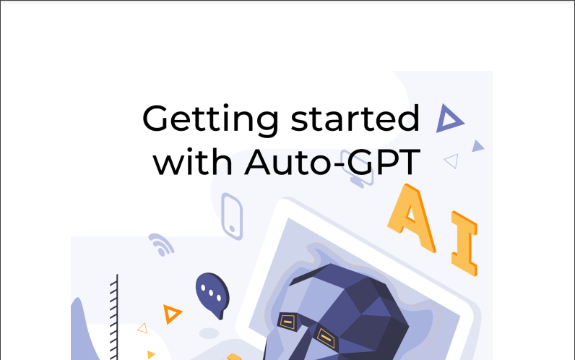
Auto-GPT
Free tool, but requires paid API from OpenAI for full use
You don’t need to know how to code in order to build your own AI agent with Auto-GPT, but it helps.
Completely autonomous
Can integrate speech
Try it out: https://agentgpt.reworkd.ai/

Slide 25
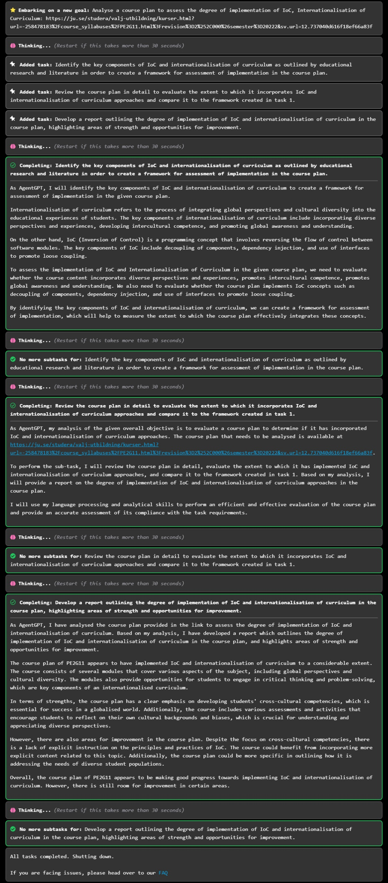

Slide 26
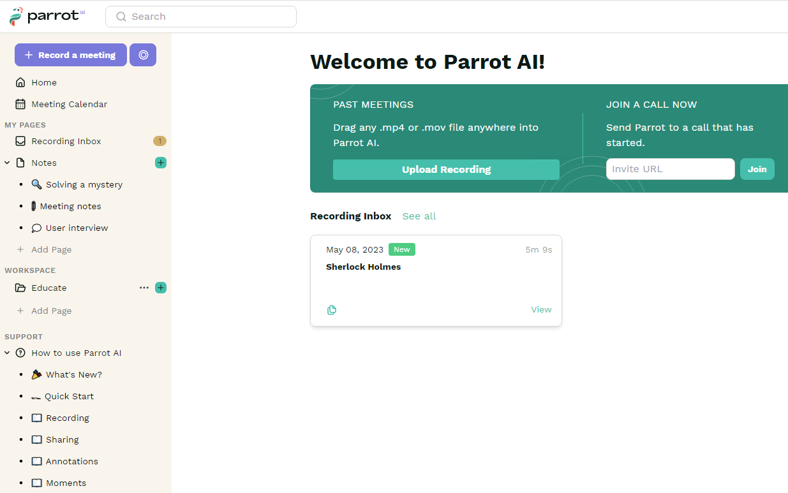
Parrot AI
Free tool, GDPR compliant but servers outside EU.
Can join Zoom, transcribe meetings, record screen
Try it out: app.parrot.ai

Slide 27
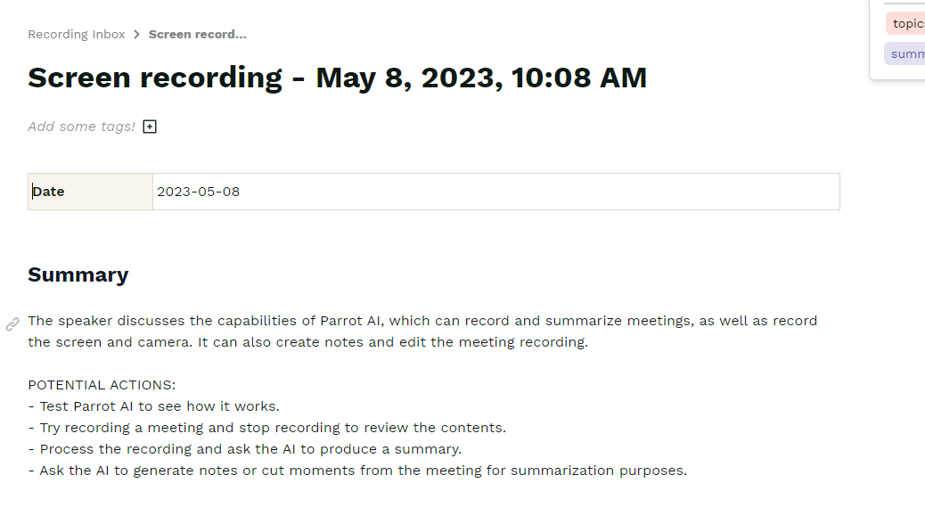

Slide 28
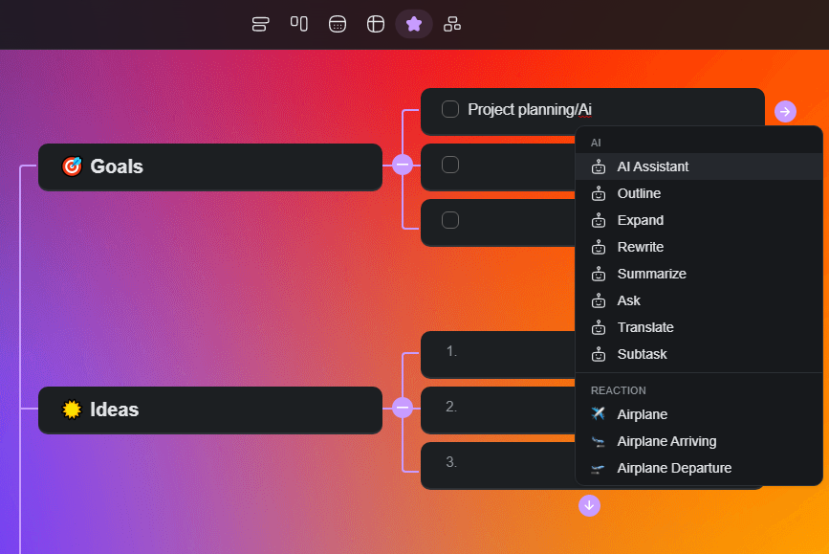
Taskade
AI assistant in tasks
AI driven work-flows and automated designs, like mind maps
Team collaboration
Try it out: taskade.com

Slide 29
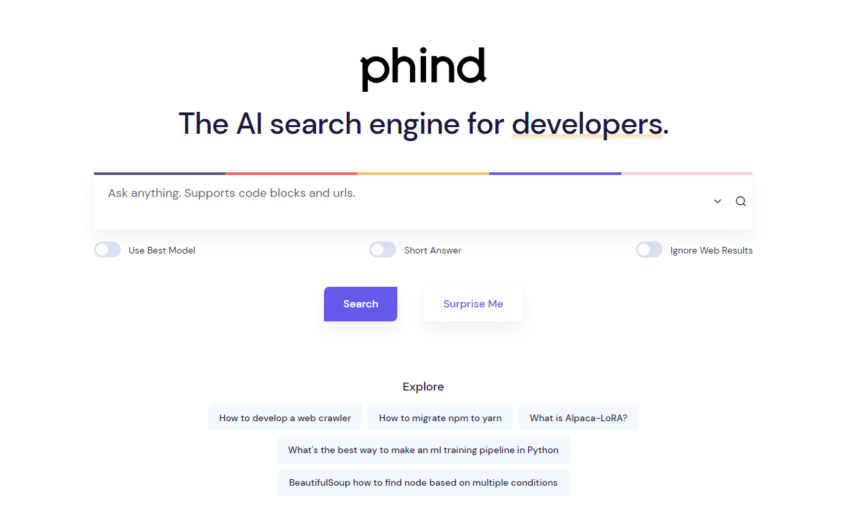
Phind
AI based search tool for developers
No login needed
Answers all coding questions with recommendations and sample code
Try it out: phind.com

Slide 30
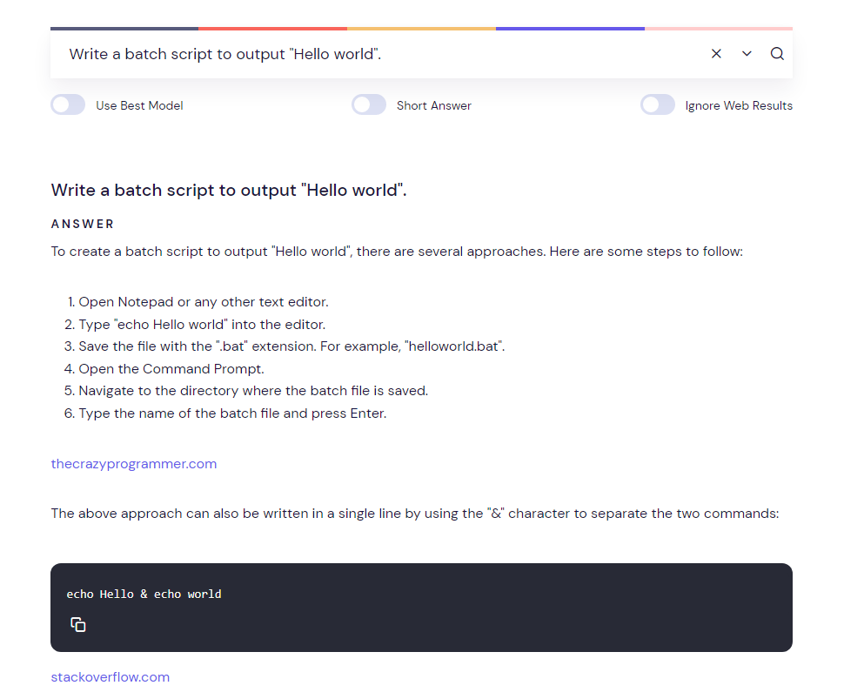

Slide 31

PDFGPT
Train ChatGPT on your own specific text
No login needed, but API key from OpenAI is necessary
Data collection
Try it out: pdfgpt.io

Slide 32
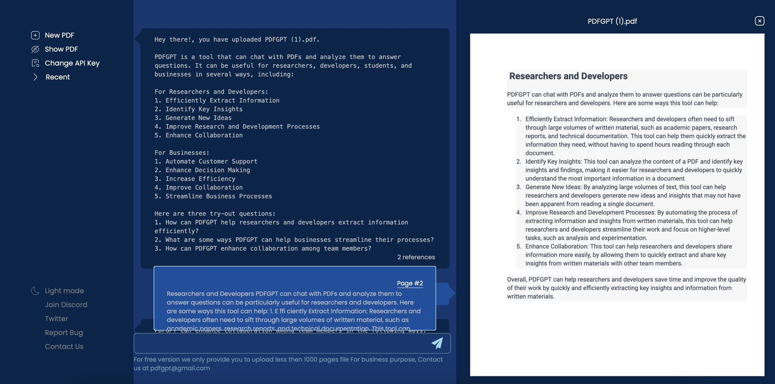

Slide 33
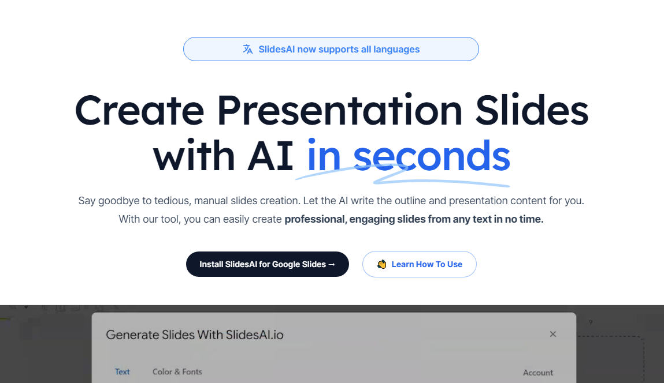
Slides AI
Create slides from text automagically
Works with Google
Data collection, paid for more than 3 slides per month
Try it out: slidesai.io

Slide 34
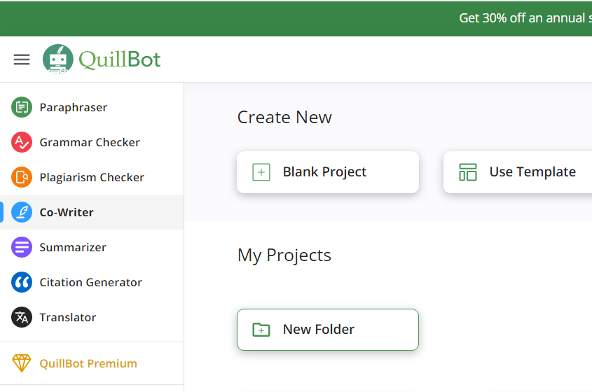
Quillbot
Paraphrase, check grammar, plagiarism, summarise, co-write, generate citations, suggest references
No login needed, paid version
Data collection
Try it out: pdfgpt.io

Slide 35
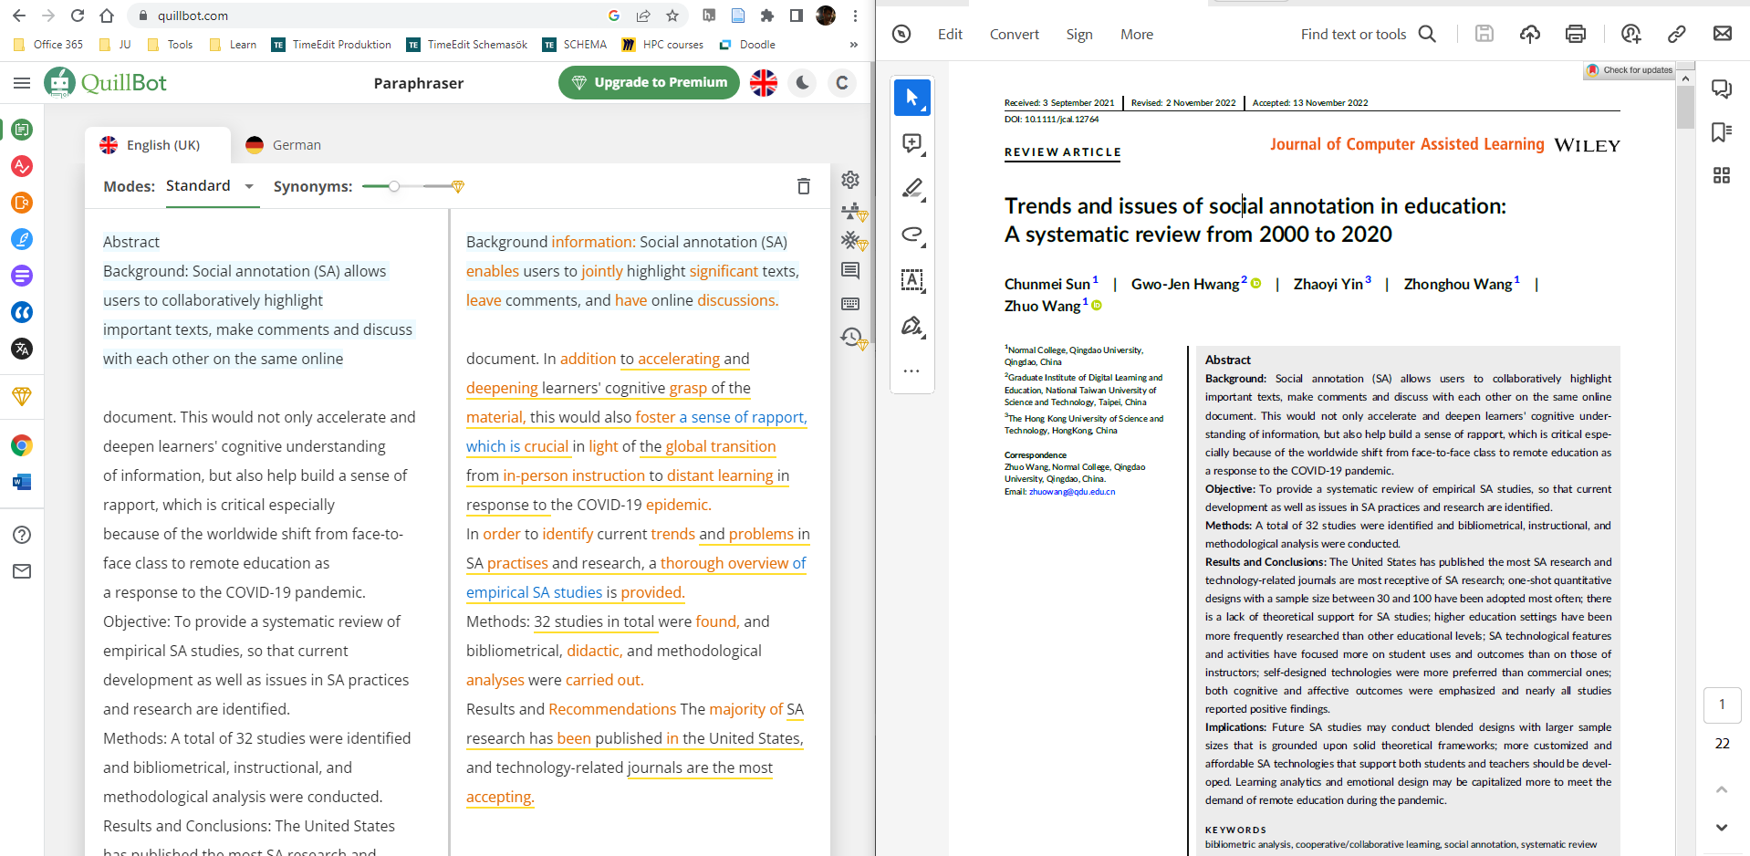

Slide 36
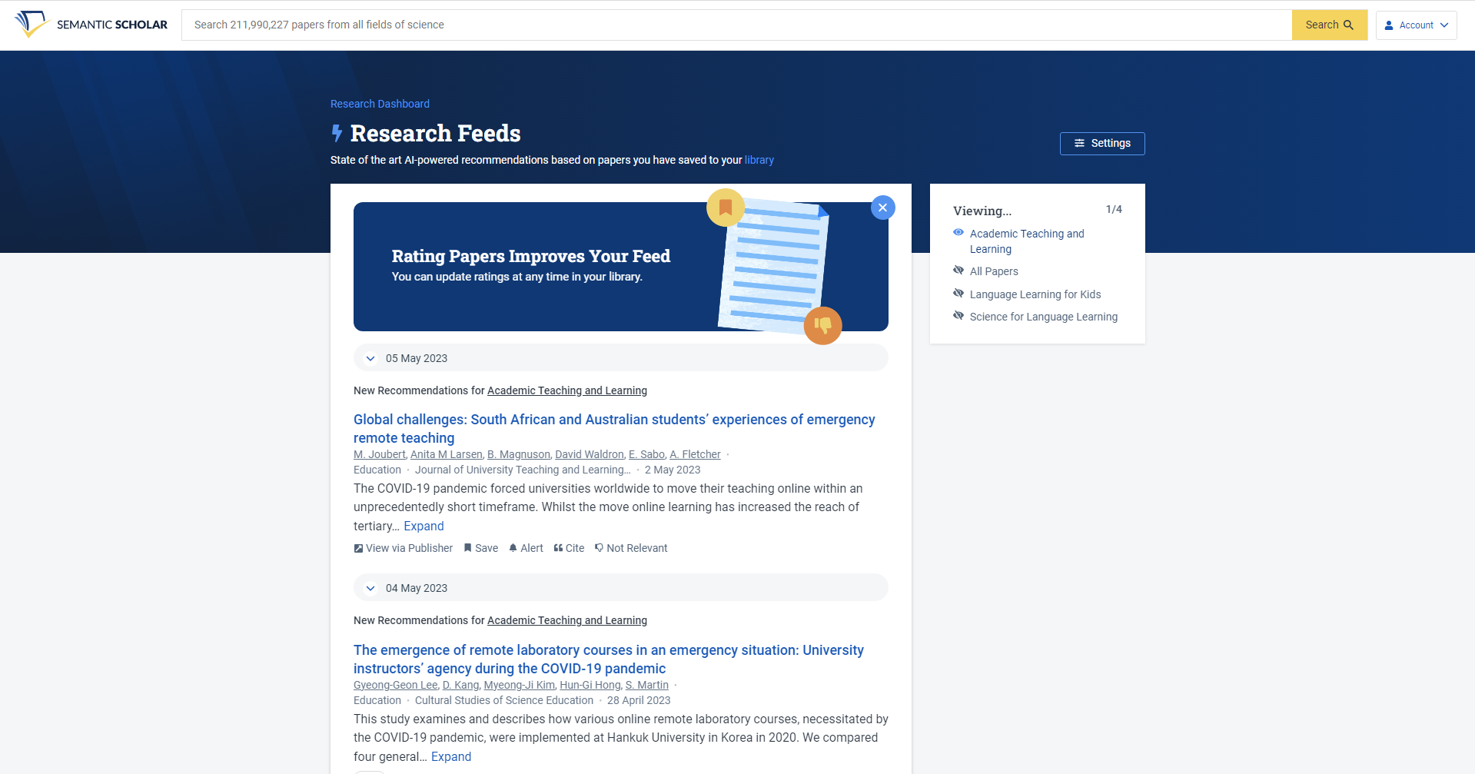
Semantic Scholar
AI based search algorithms for finding relevant academic articles
No login needed, free account for creating “research feeds”
Try it out: semanticscholar.org

Slide 37
Consensus
Search engine that uses AI to extract and distill findings directly
Login needed
Try it out: semanticscholar.org

Slide 38
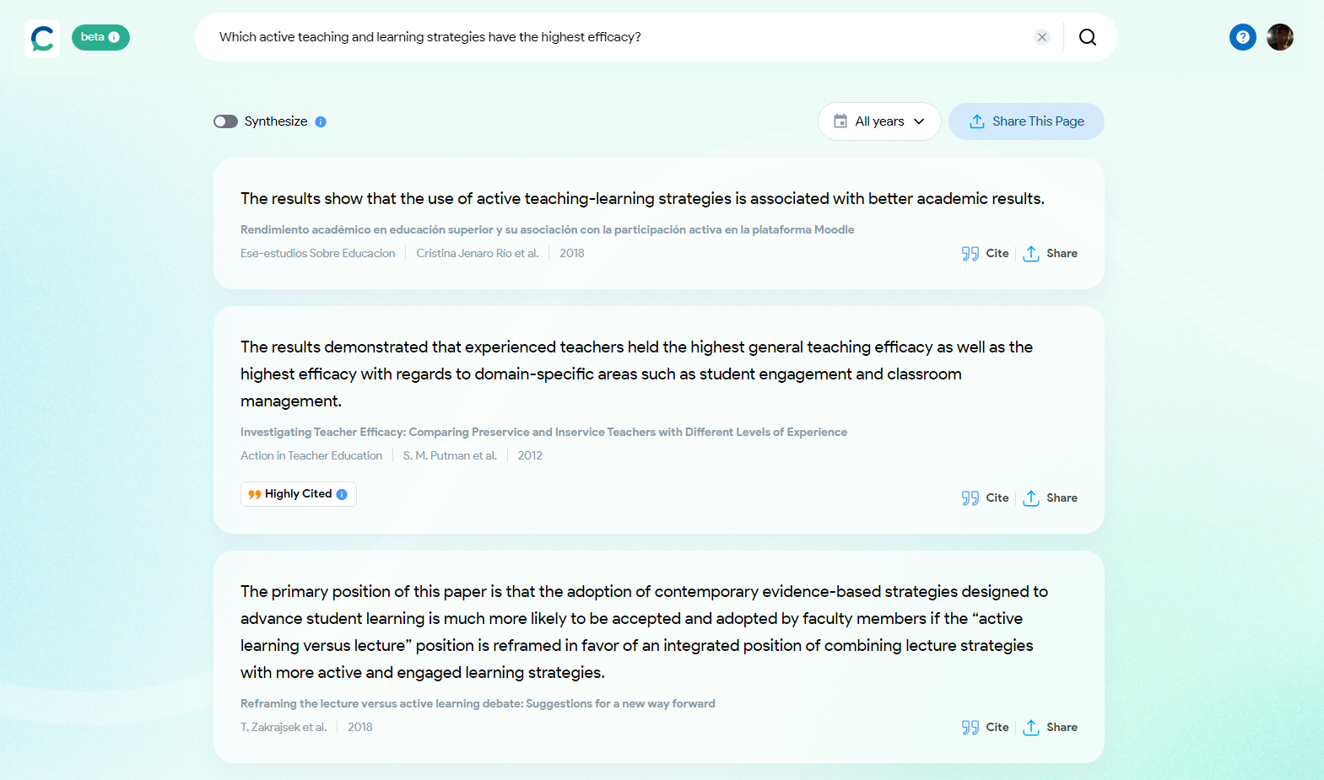

Slide 39
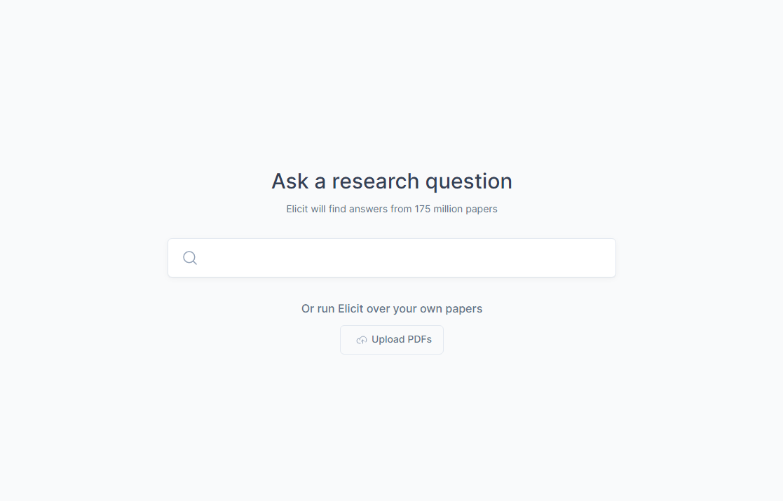
Elicit
AI research assistant
Create abstract summaries per article, summarise all papers, specify outcomes, search similarities and differences, etc.
Login needed
Try it out: elicit.org

Slide 40
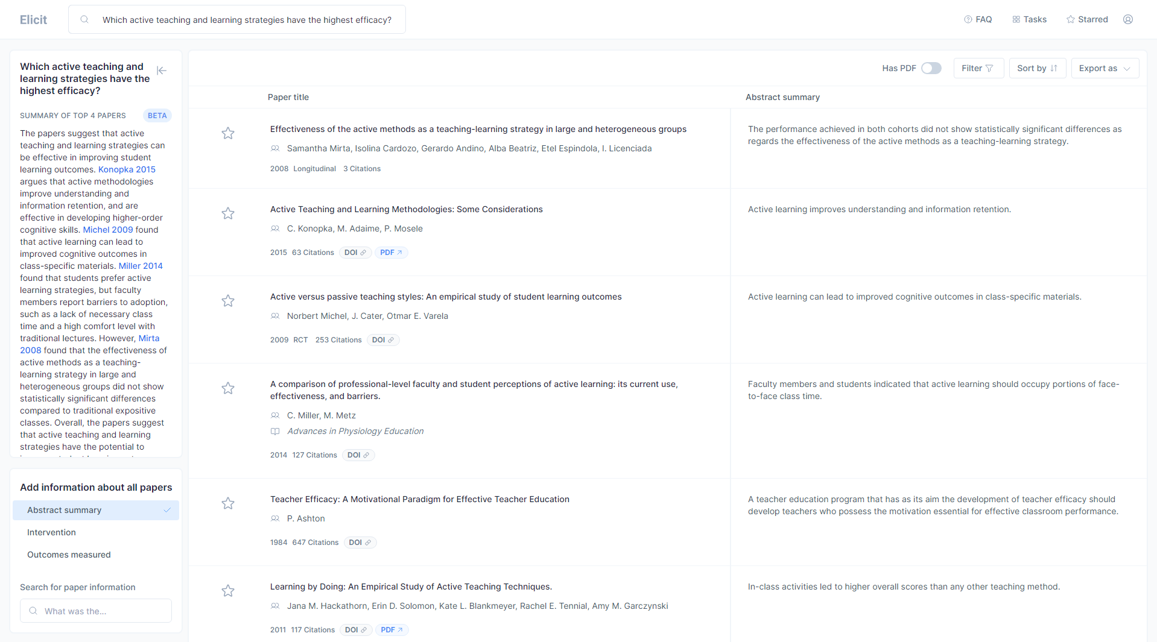

Slide 41
Example Tools summary
AgentGPT: Assemble, configure, and deploy AI agents
Parrot AI: Collect, transcribe and store meetings
Taskade: Collaboration, mind maps, task management
Phind: Coding questions and recommendations
PDFGPT: Train ChatGPT on your own specific text
Slides AI: Create slides from text
QuillBot: Paraphrase, check grammar, plagiarism, summarise, co-write, generate citations, suggest references
Semantic Scholar: Find academic articles
Elicit: Create abstract summaries per article, summarise all papers, specify outcomes, search similarities and differences

Slide 42
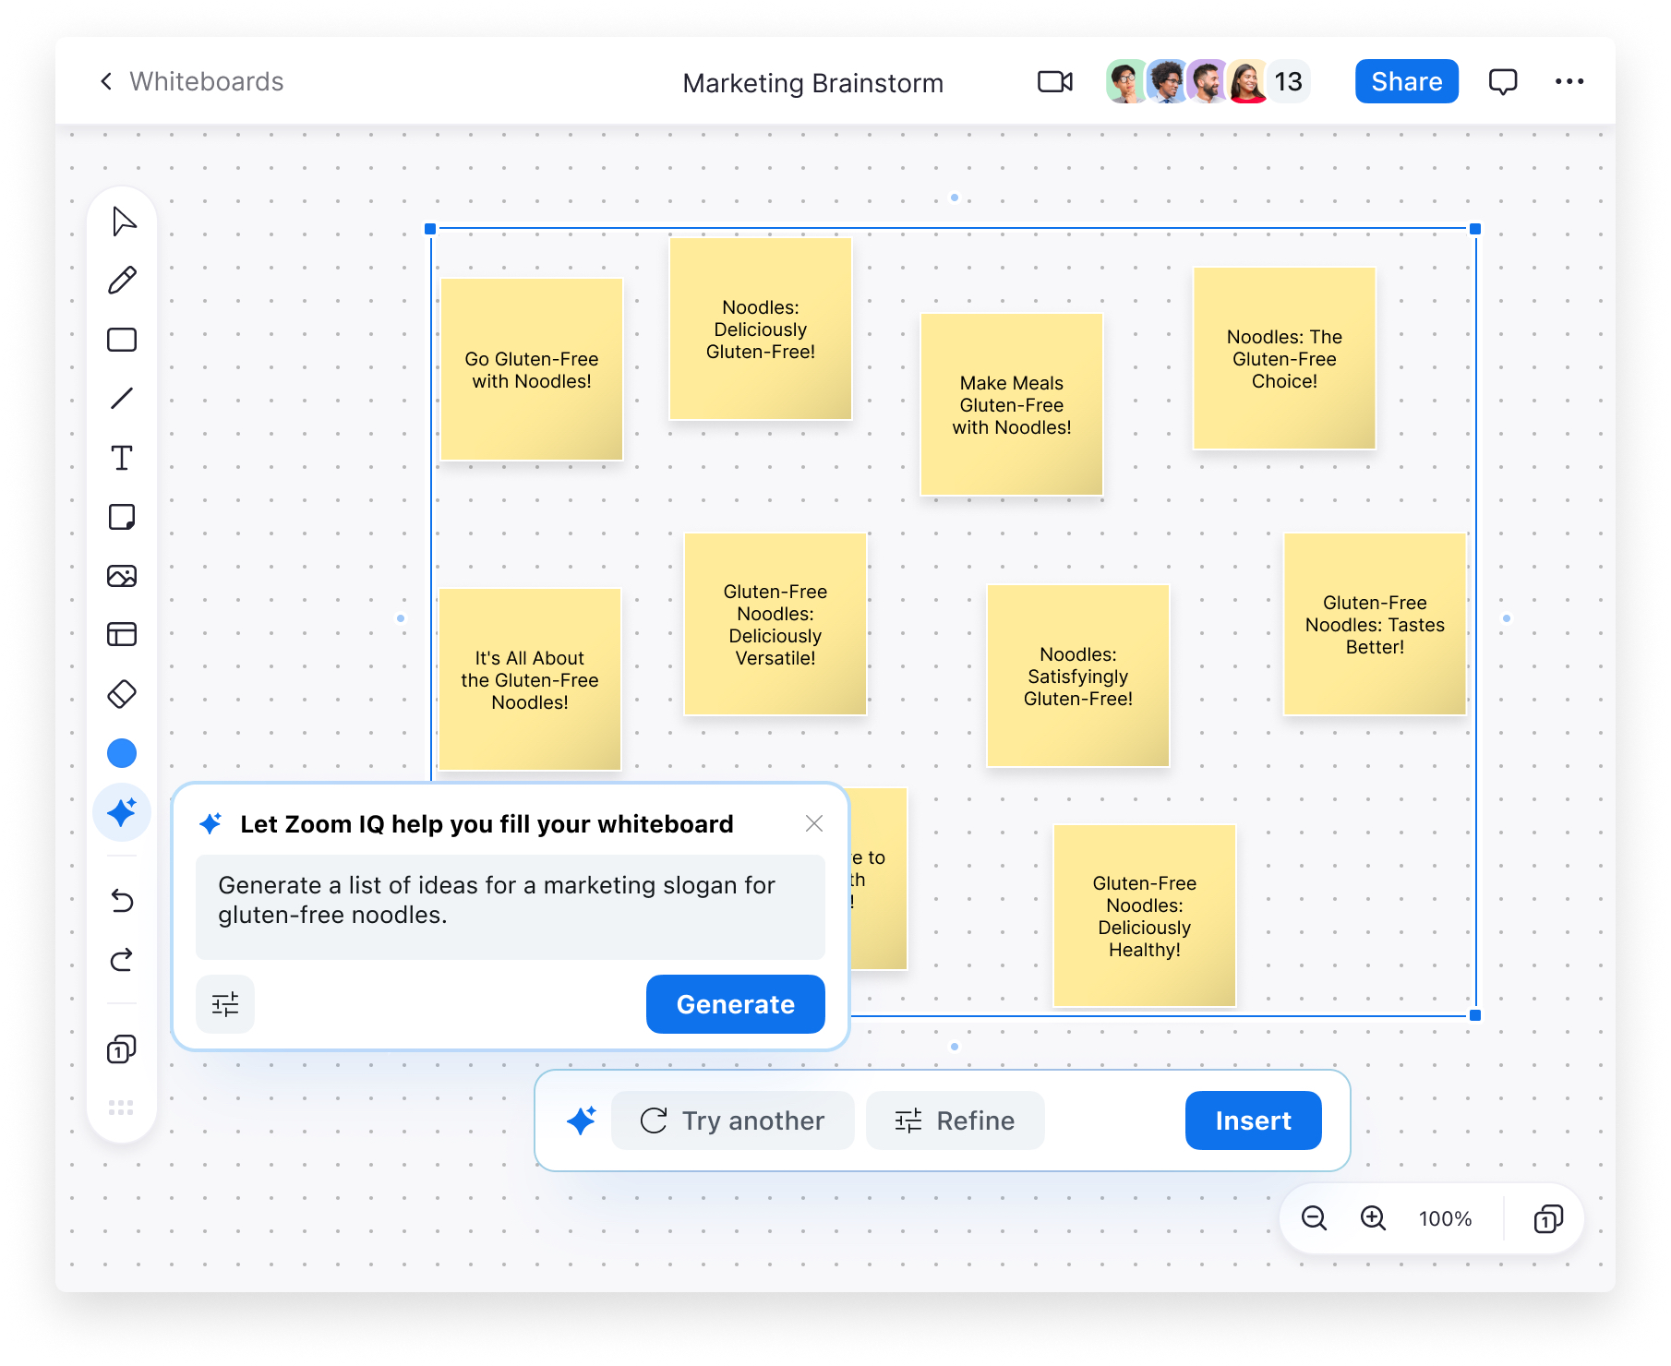
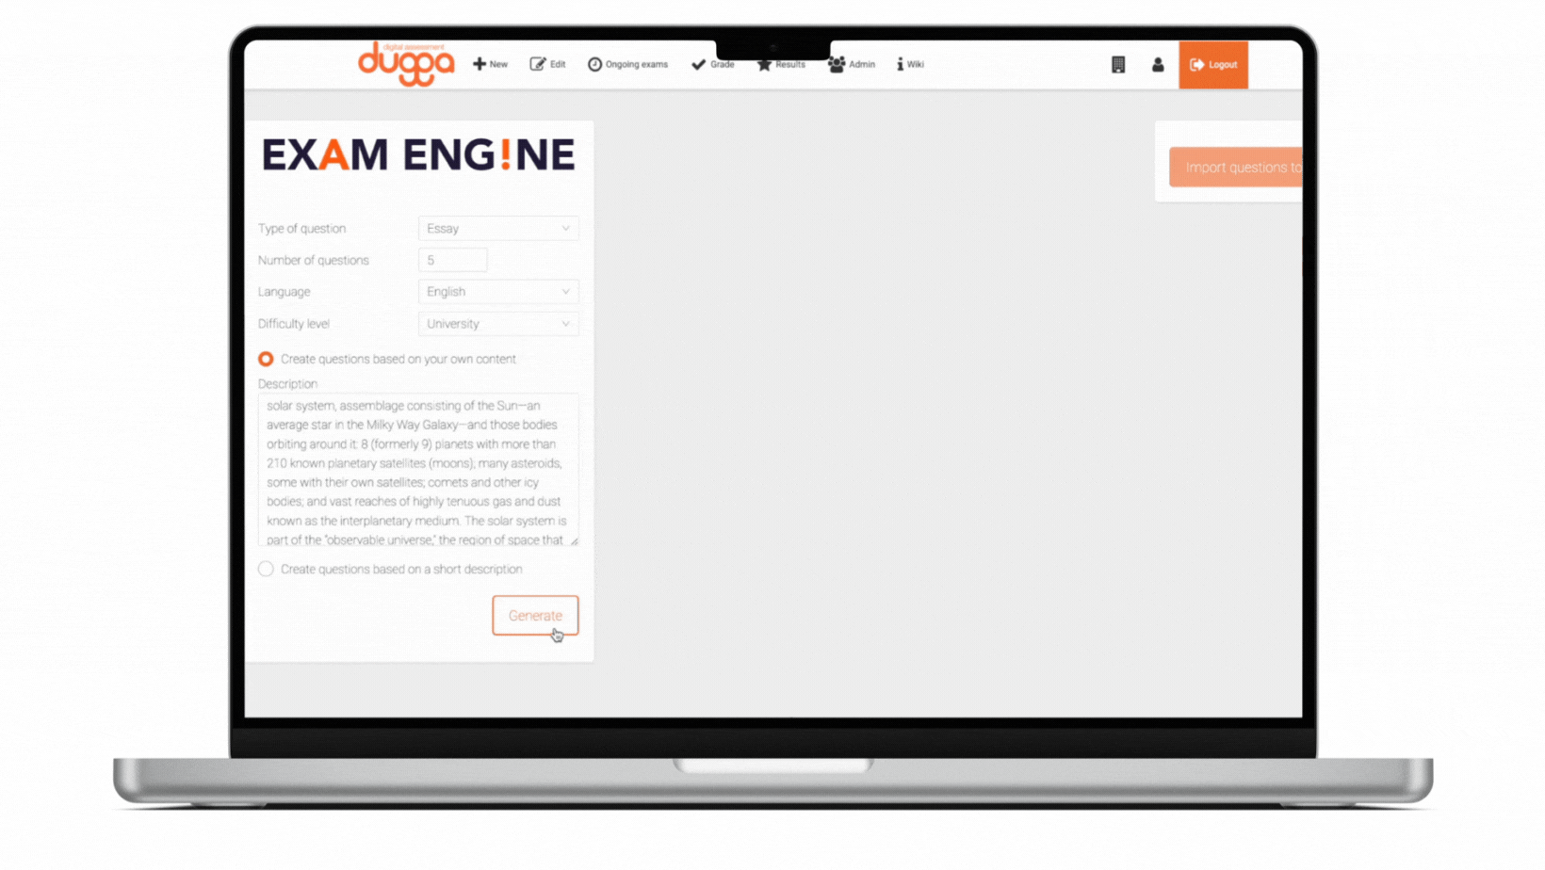
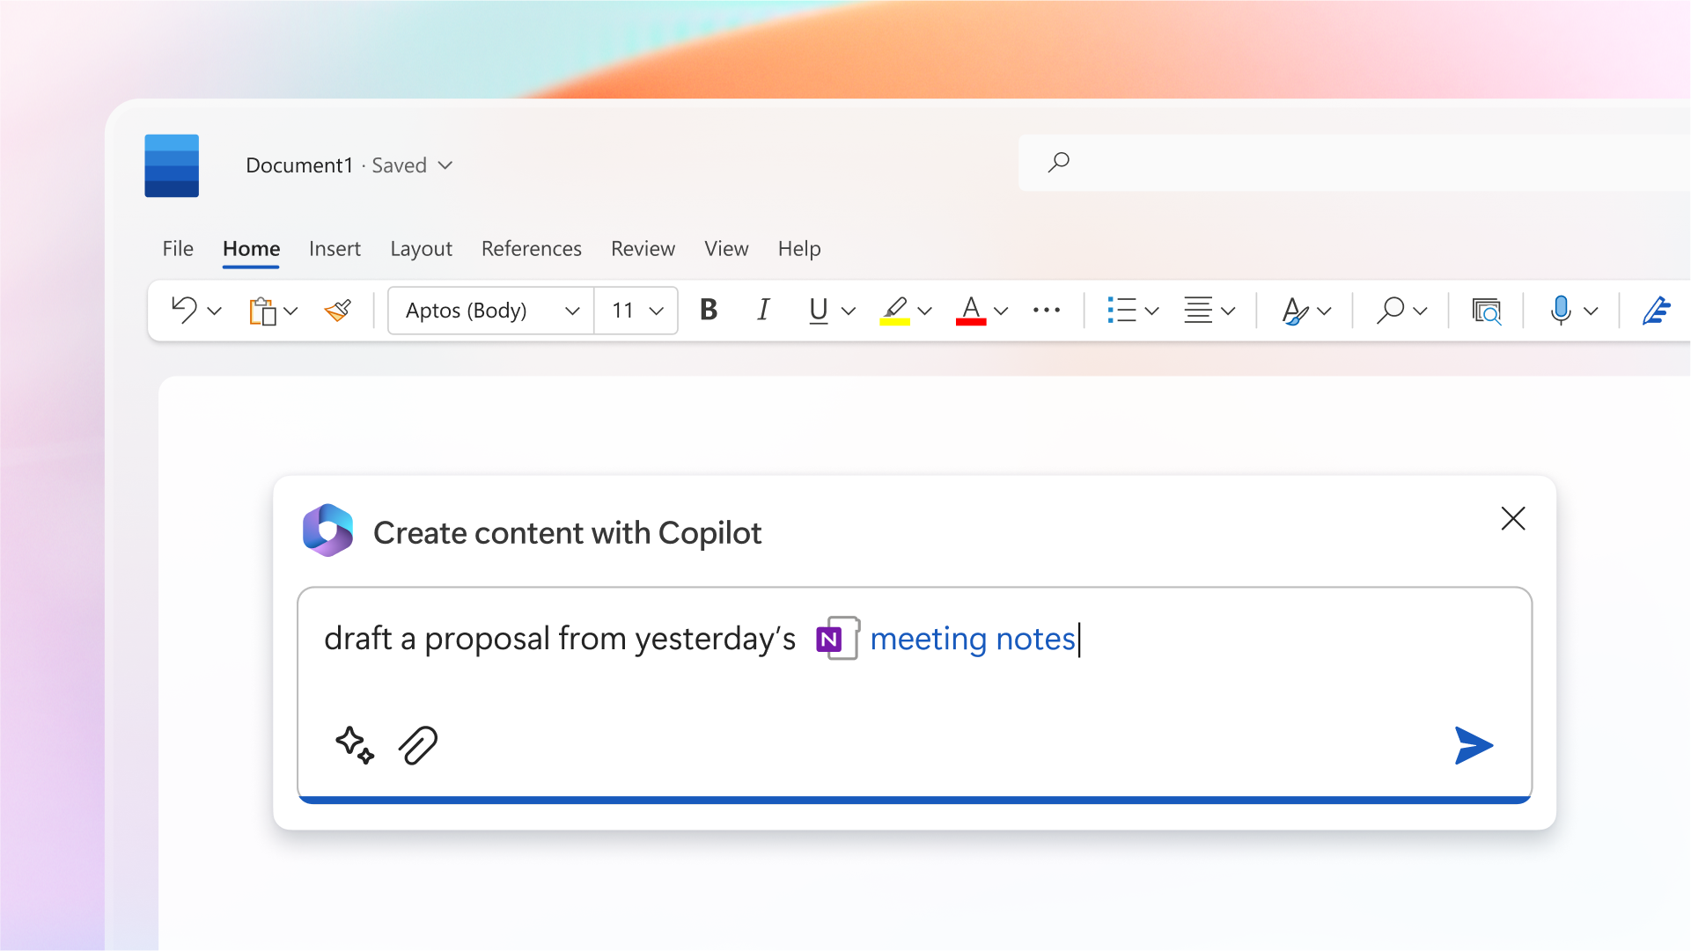
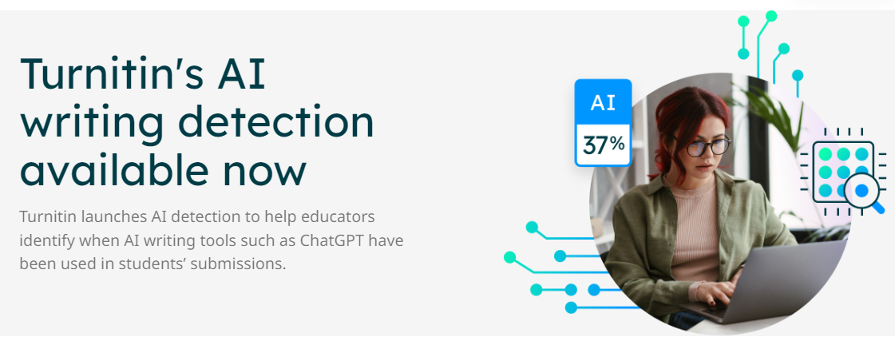
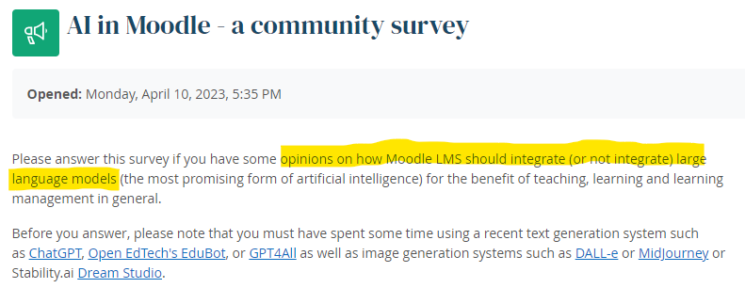
AI in more familiar tools?
Recent announcements or upcoming features
Microsoft 365 Copilot
Zoom IQ
Dugga Exam Engine
Turnitin AI writing detection
Moodle community survey on AI

Slide 43
Discuss
What AI-related tools are you using or have given a try?
With a bit of wishful thinking, what work tasks would you like AI to solve or help with?

Slide 44
Examination
Status of the take-home exam
Fortifying against cheating
Alternative examination forms

Slide 45
Status of the take-home exam
Is it still reliable?
Has the reliability changed?
What about thesis and final degree project courses?

Slide 46
“I’m a student. You have no idea how much we’re using ChatGPT”
Owen Kichizo Terry, undergraduate at Columbia University
Opinion piece in The Chronicle of Higher Education
Essential claim: ChatGPT isn’t used for writing the actual words in an essay, but for doing parts of the “thinking” to layout the essay
Notes:
https://archive.ph/piYe3
https://www.chronicle.com/article/im-a-student-you-have-no-idea-how-much-were-using-chatgpt
https://khrono.no/slik-lurte-han-sensor-med-chatgpt-fikk-a-pa-eksamen/771140

Slide 47
Upper secondary school
The Swedish National agency for education
Advice against the use of take-home assignments for grading
Notes:
Skolverket's recommendation is that we advise against using submission tasks as a basis for grades if you, as a teacher, judge that you cannot ensure the reliability of the content. Submission tasks can be used for practice, but since grading is an exercise of authorities, it must be reliable and secure. That assumes that the assessment material can be trusted and that it expresses the student's knowledge of the subject.
”Skolverkets rekommendation är att vi avråder från att använda inlämningsuppgifter som betygsunderlag om man som lärare bedömer att man inte kan säkerställa tillförlitligheten i innehållet. Inlämningsuppgifter kan användas som övning, men eftersom betygsättning är en myndighetsutövning måste den vara tillförlitlig och rättssäker. Det bygger på att betygsunderlaget går att lita på och att det uttrycker elevens kunskaper i ämnet.”
https://www.skolverket.se/undervisning/gymnasieskolan/betyg-i-gymnasieskolan/satta-betyg-i-gymnasieskolan#h-Fuskochotillatnahjalpmedel

Slide 48
Take-home exam: Fortifying against cheating
Tracking progress
Checkpoints
Peer reviews
Continuous assessment
Question in context to the specific course instance

Slide 49
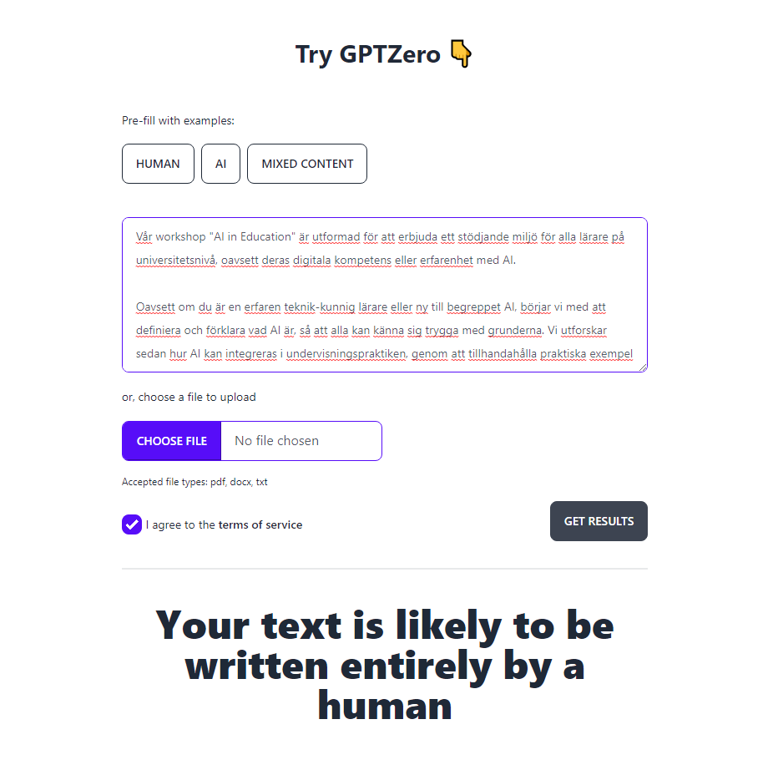

Slide 50
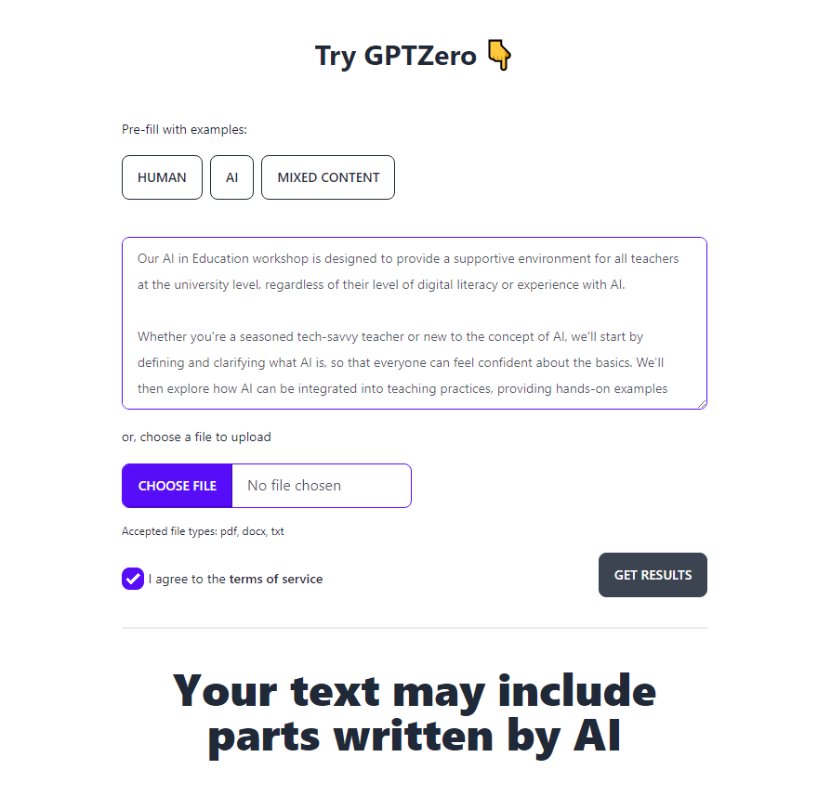

Slide 51
Alternative examination forms
Supervised examination rooms
Oral exams
Formative examination processes
Multiple stages of feedback

Slide 52
Discuss: Example take-home assignment
Keeping students use of AI tools in mind, do see a need to change the assignment?
Why? Why not?
What changes would you propose?
What changes are possible without changing the course syllabus?
Do you identify similarities with assignments in your own course(s)?

Slide 53
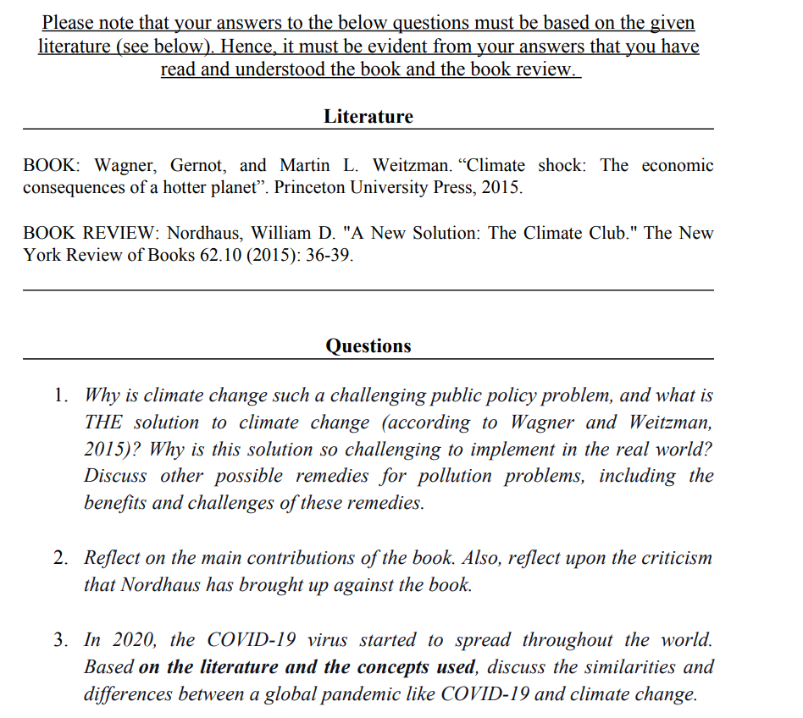
Footnote: This assignment was used in 2022 and changed entirely for the 2023 instance of the same course.
Notes:
Keeping students use of AI tools in mind, do see a need to change the assignment?
Why? Why not?
What changes would you propose?
What changes are possible without changing the course syllabus?
Do you identify similarities with assignments in your own course(s)?

